Slide 1

EDSA_PT_2023 Integrated project
Insurance industry in Africa
Rolindela Liphadzi

Slide 2
Problem statement
Although Africa makes up a significant portion of the global population, the insurance industry in the continent is underdeveloped and represents only a small fraction of insured catastrophe losses worldwide.
The total value of insurance premiums is relatively low, and there is an unwelcoming mindset among potential clients questioning the necessity of spending money on insurance for risks that might not materialize.
Additionally, the economic imbalances within Africa, with a high unemployment rate and varying income levels, create challenges in identifying and targeting potential clients who can benefit from insurance coverage.

Slide 3
Problem Landscape
Data
Information on current clients
Current client’s demographic and regional information
Various income levels and sources of income
Education level and employment status
Information
Common misconceptions and clarifications.
Information on the long-term advantages of insurance.
Details on tailored and affordable insurance products.
Pricing models and coverage options.
Comparative information on various insurance offerings.
Profiles of specific demographics with higher risk exposure.
Insights into their unique concerns and needs.
Information on cultural factors influencing insurance decisions
Knowledge
Data analytics results for targeted marketing.
Risk assessment insights for product development.
Trends and patterns in insurance uptake.
Insights into potential regulatory changes impacting the project.
Knowledge of successful insurance implementations.
Information on the impact of insurance in mitigating financial losses.

Slide 4
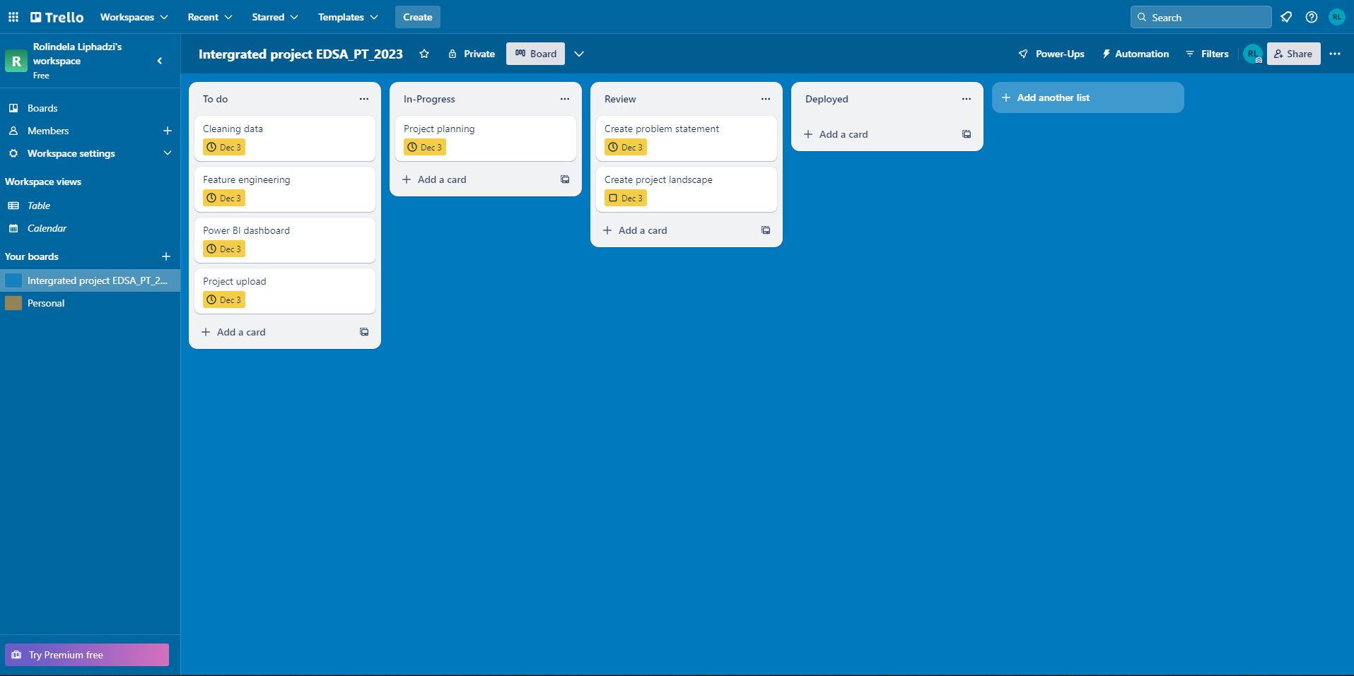
Trello board

